Slide 1
BRIEN HOLDEN VISION INSTITUTE SOCIAL RESPONSIBILITY

Slide 2
Aims
This unit aims to outline some of the main elements of social responsibility
The topics to be discussed are:
Gender Equity
Disability Inclusiveness
Child Protection
Environment

Slide 3
Gender Equity

Slide 4
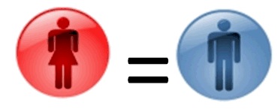
Gender Equity – What is it?
When women and men have equal opportunities to realise their individual potential, to contribute to their country's economic and social development and to benefit equally from their participation in society

Slide 5
Gender Equity – What is it?
When women & men have relative equality,
economies grow faster,
children's health improves and
there is less corruption
http://www.youtube.com/watch?v=N4ok_5D27BY

Slide 6
Current Status…
While gains have been made, gender inequities are still striking:
2/3 of the 800 million people in the world who lack basic literacy skills are female
women hold an average of 3% of seats in national parliaments in Pacific island countries,
and an average of 19% of seats in East Asia
500,000 women die each year from complications during pregnancy
99 % of them in developing countries.
globally 1 in 3 women and girls experience physical and sexual violence
Ref: http://www.unifem.org/gender_issues

Slide 7
Gender Equity
Gender equity is not a women’s issue but should concern and fully engage men as well as women.
Equity between women and men is seen both as a human rights issue and as a precondition for, and indicator of, sustainable people-centered development.

Slide 8
Gender and Eye Care
Women suffer from over double the amount of blindness and vision impairment
Women and girls access eye care services less than men and boys
Cataract rates are higher in women than in men
Women account for 75% of trachoma blindness
In many settings women are two to four times as likely to have trichiasis
Presbyopia rates appear to be higher in women compared with men

Slide 9
What can we do?
Strategies and targets need to engage women and girls, and the effectiveness of these strategies needs to be monitored
Gender data is collected through our projects
This allows us to implement strategies to help redirect health promotion activities and awareness campaigns, selection and recruitment of human resources

Slide 10
Questions for discussion
You examine the monitoring and evaluation data for your clinic. You discover that 80% of the people you see are males.
What are some reasons to explain this?
How can we change this?

Slide 11
Possible Discussion Answers
What are some reasons to explain this?
Females are working during the hours the clinic operate
Females feel it is not their right to access the clinic (glasses are only for those who are educated or males)
Females are less likely to be education, and may not be aware of services or treatment available
Females have no means of transport
Females cannot access the household income so can not afford glasses

Slide 12
Possible Discussion Answers
How can we change this?
Change opening hours to make it more accessible
Targeted awareness programmes and education e.g. workshops/screenings with women’s groups
Outreach services or provide transportation
Educate men that everyone needs access to eye care

Slide 13
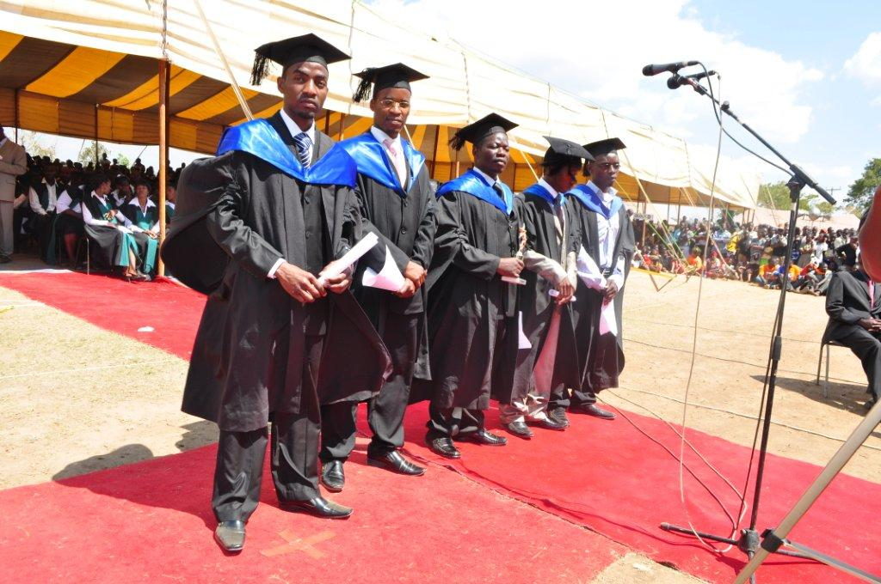
What’s wrong with this picture?

Slide 14
6 Steps to Gender Equity
Know the facts
Recognise it’s not a women’s issue
Get leadership on board
Set targets
Identify motivated individuals and invest
Accountability
Ref: http://curt-rice.com/Steps-to-Gender-Equality1.pd

Slide 15
Gender equity considerations: optometry schools, education courses, vision centre/eye clinic
Advocacy for the commitment of gender equity for the school / university aligned with gender empowerment policies of the country
Development of a gender policy for the school or institution
Affirmative action for enrolments
Affirmative action for employment
Development of a women’s support group
Research program to understand barriers an enabling factors to increase female students and faculty
Clinical services and outreach services to target females
Measurement of gender specific interventions – analysis of disaggregated data
Communication and advocacy of issues and interventions – create awareness.

Slide 16
Gender equity – suggested reading
Millennium Development Goals – Gender Empowerment: http://www.un.org/millenniumgoals/gender.shtml
www.unfpa/gender/empowerment.htm
www.unifem.org/gender_issues
http://www.undp.org/content/undp/en/home/librarypage/womens-empowerment.html
http://www.oecd.org/dac/gender-development/policybriefsongenderequalitywomensempowermentanddevelopment.htm

Slide 17
Disability Inclusiveness

Slide 18
Disability
Disability is an umbrella term, covering impairments, activity limitations, and participation restrictions.
Impairment is a problem in body function or structure;
an activity limitation is a difficulty encountered by an individual in executing a task or action;
while a participation restriction is a problem experienced by an individual in involvement in life situations.
Thus, disability is a complex phenomenon, reflecting an interaction between features of a person’s body and features of the society in which he or she lives.
World Health Organisation 2001

Slide 19
Disability – current status
People with disability are among the poorest and most vulnerable in developing countries
It is estimated that 650 million people have a disability and about 80% live in developing countries
People with disability may have problems accessing education or health services or earning a living
This can affect quality of life and drive people into poverty
United Nations http://www.un.org/disabilities/convention/facts.shtml

Slide 20
Barriers for people with disability
Barriers for people with a disability include:
Access
Opinions/stigma
Communications
We need to think about making our services accessible for all

Slide 21
Discussion question
What are some strategies that you can apply to your day to day work to help to ensure accessibility for persons with disabilities?

Slide 22
Possible Discussion Answers
Access
This can include:
Ensuring that there is easy access to services E.g. on the ground floor or a ramp
Conducting vision screenings in aged care facilities
Opinions/Stigma
Do not make assumptions about what people with disabilities can and cannot do
Communication & Interactions
Consider the most appropriate type of communication or using multiple modes- e.g. verbal and/or written when giving instructions

Slide 23
Disability Inclusiveness considerations: optometry schools, education courses, vision centre/eye clinic
Advocacy for the commitment of disability inclusiveness for the school / university aligned with disability inclusiveness policies of the country
Development of a disability inclusiveness policy for the school
Affirmative action for enrolments
Affirmative action for employment
Research program to understand barriers and enabling factors to increase providing eye care to those living with a disability
Clinical services and outreach services to target those with disability
Accessibility to services e.g. ramp
Development of the LV program and expertise
Development of linkages with disability organisations
Development of a CBR program
Measurement of interventions and service provision – analysis of disaggregated data
Communication and advocacy of issues and interventions – create awareness

Slide 24
Disability – suggested reading
http://www.un.org/disabilities/convention/facts.shtml
http://www.disabilityrightsfund.org/resources.html
Include Everybody campaign on disability and MDGS: http://www.includeeverybody.org/
International Disability and Development Consortium (IDDC): http://www.iddcconsortium.net/joomla/
International Information Support Centre for introductory CBR resources and manuals: http://asksource.ids.ac.uk/cf/keylists/keylist2.cfm?topic=dis&search=QL_DISCBR05
The Lancet special issue on disability http://www.thelancet.com/themed-disability
United Nations Enable for details of the UNCRPD and on the MDGs and disability: http://www.un.org/disabilities/
World Health Organization (WHO)
Disability and rehabilitation team: http://www.who.int/disabilities/en/
MDGs and disability: http://www.who.int/disabilities/media/events/idpdinfo031209/en/print.html
CBR matrix: http://www.who.int/disabilities/cbr/CBR%20MATRIX%202008%20update.pdf
WHO, ILO and UNESCO CBR Joint position paper 2004: http://www.who.int/disabilities/cbr/en/
United Nations Development Programme
http://www.undp.org/content/undp/en/home/ourwork/povertyreduction/focus_areas/focus_inclusive_development/
http://www.inclusivedevelopment.net/
http://www.inclusive-development.eu/
World Report on Disability: [external link, PDF 10.44MB], EasyRead version: [external link, PDF
2.68mb], World Health Organization and World Bank (2011) World Report on Disability. Geneva:
WHO Press

Slide 25
Child Protection

Slide 26
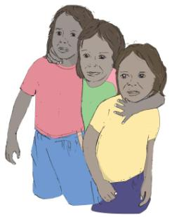
What is child protection?
Child protection is about protecting children from abuse, violence or exploitation (being taken advantage of)
There are different types of child abuse:
Physical, emotional, sexual & neglect
All types of abuse have an affect on children
It is important as children often cannot tell us that something is wrong

Slide 27
What do we need to do?
We need to make sure that we:
do not do anything that can be interpreted as harming a child
take care of children that we interact with
look out to make sure that children we work with are not hurt by others
seek permission before taking photos of children

Slide 28
Challenges
How children are treated in different situations can vary between countries. Why do you think this may be?
Personal views
Law / Legislation
Amounts of Information
Own values and own experiences
Cultural values
Religion / beliefs

Slide 29
Question for discussion
You are planning a vision screening in a primary school. How will you minimise the child protection risks:
In planning the project?
In your own behaviour?

Slide 30
Possible Discussion Answers
Project considerations:
Ensure there is an adequate staff/child ratio
Provide adequate supervision of staff and activities
Minimise opportunities for children to be isolated by a staff member
Use open plan spaces

Slide 31
Possible Discussion Answers
Personal considerations:
Avoid situations where you are alone with a child
Do not kiss or cuddle a child
Never smack or hit a child
Never make rude remarks about a child even as a joke
Do not photograph or video a child without consent of the child and his/her parent or guardian
Avoid unnecessary physical contact

Slide 32
Environment

Slide 33
What is the environment?
The Institute broadly defines “environment” to include human surroundings (the conditions under which people live including the quality of housing, quality of settlements and social capital), in addition to natural surroundings and ecological processes.
We recognise inextricable links between communities of humans and their environment, including but not limited to livelihood and quality of life.
This definition is adapted from the 1994 AusAID Environment Audit, pp 6

Slide 34
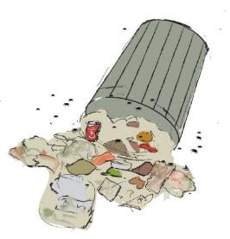
What is the environment?
Built environment
Conditions in which people live e.g., housing
Natural environment
Our natural surroundings e.g., air or water quality
Good environments help people to be healthy, earn a livelihood and have good quality of life
The greatest impact of poor environment occurs on poor and marginalised people

Slide 35
How can environment affect vision?
Increased ultraviolet light levels and ambient temperature appears to:
Increase the incidence of pterygia, eye cancers, cataract and presbyopia
Increase the prevalence and severity of ocular infections
Air-borne pollutants cause ocular surface irritation
All of these factors can affect vision and decrease a person’s quality of life

Slide 36
Questions
What are some environmental measures that we should think about in our projects
When planning a Vision Centre?
When planning vision screenings?

Slide 37
Possible Discussion Answers
Using email instead of travel
Reducing paper use
Turning off electrical appliances when not in use (eg computers and lights)
Furniture purchased is locally made with appropriate local materials
Rainwater tanks to supply optical laboratories
Recycle water where possible
Use washable cloths rather than disposable tissues for cleaning lenses

Slide 38
Environmental considerations: optometry schools, education courses, vision centre/eye clinics
Advocacy for the commitment of environmental consideration and policy for the school / university aligned with environmental legislation and policies of the country
Development of an environment policy for the school
Research program on the impact of changing environmental factors on eye care
Invest in rainwater tanks to supply optical laboratories whenever feasible
Recycle water in optical laboratories whenever feasible
Filter solid waste from auto-edger waste water and are appropriately plumbed to sewage systems where available, rather than releasing waste water into natural waterways
Remove solid waste from the laboratory in hygienic and safe manner
Limit noise production to ambient environmental levels, and only at appropriate times of the day
Use washable cloths rather than disposable tissues for cleaning lenses
Use existing buildings rather than construct new buildings whenever possible (to conserve embodied energy)
Retro-fit existing buildings to improve environmental standards whenever possible (e.g. external and internal blinds, eves, insulation, doors to compartmentalize so that air-conditioners are not used to cool unnecessary areas)
Ensure that any new buildings required are appropriately positioned and designed for local town planning requirements and best-practice environmental standards, and use appropriate local materials (such as bamboo rather than unsustainable rainforest timbers)
Purchase furniture that is locally made using appropriate local materials (such as bamboo rather than unsustainable rainforest timbers)
Assessment and evaluation of environmental impact
Communication and advocacy of issues and interventions – create awareness

Slide 39
Environment – suggested reading
Protecting Health from Climate Change – connecting science, policy and people. World Health Organization 2009
Aligning Regional and Global Disaster Risk Reduction Agendas. Global Platform for Disaster Risk Reduction, UNISDR 2011
Disaster Risk Reduction, Climate Change Adaptation and Environmental Migration. A Policy Perspective. International Organization for Migration 2009
Report of the World Commission on Environment and Development - Our Common Future. UN 1987

